Slide 1
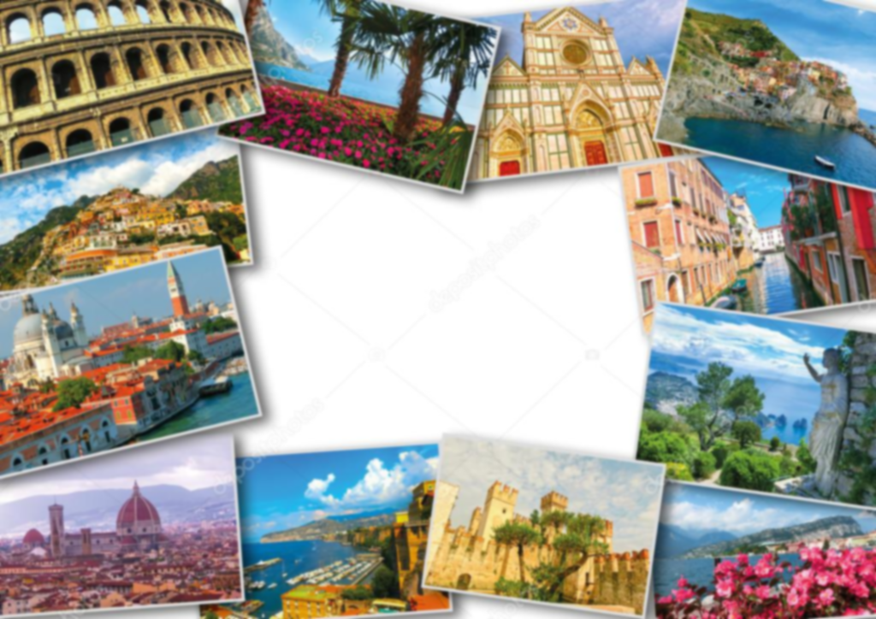
ITALY by: Shona Murray, 6th Class

Slide 2
Contents
Introduction
Geography and Statistics
Culture and people
Nature
Food
Famous landmarks
Fashion

Slide 3
Introduction
Hello, this is my project on Italy. I’ve worked very hard on it and I really hope you enjoy it!!

Slide 4
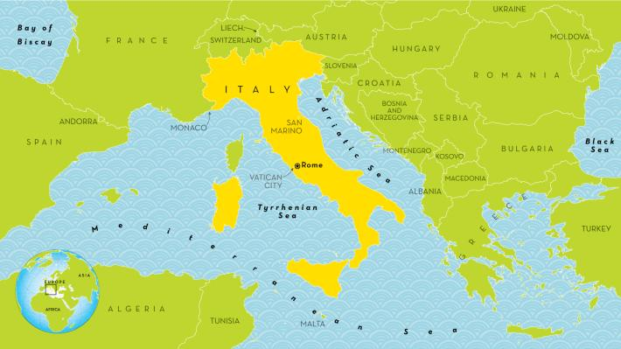
Geography and Statistics
Italy is a boot-shaped peninsula that juts out of southern Europe into the Adriatic Sea, Tyrrhenian Sea, Mediterranean Sea, and other waters. Its location has played an important role in its history. The sea surrounds Italy, and mountains crisscross the interior, dividing it into regions. The Alps cut across the top of the country and are streaked with long, thin glacial lakes. From the western end of the Alps, the Apennines mountains stretch south down the entire peninsula. West of the Apennines are wooded hills that are home to many of Italy's historic cities, including Rome. In the south there are hot, dry coastlands and fertile plains where olives, almonds, and figs are grown.
The official name for Italy is Italian Republic which means the form of government is a republic. The capital city of Italy is Rome. Italy has a population of 62 million, the official language of Italy is Italian. Their currency is Euro. They have an area of 301,277 square kilometres. The major mountain ranges are The Alps and The Appenines and the major rivers are the Po, Tiber, Adige and Arno.

Slide 5
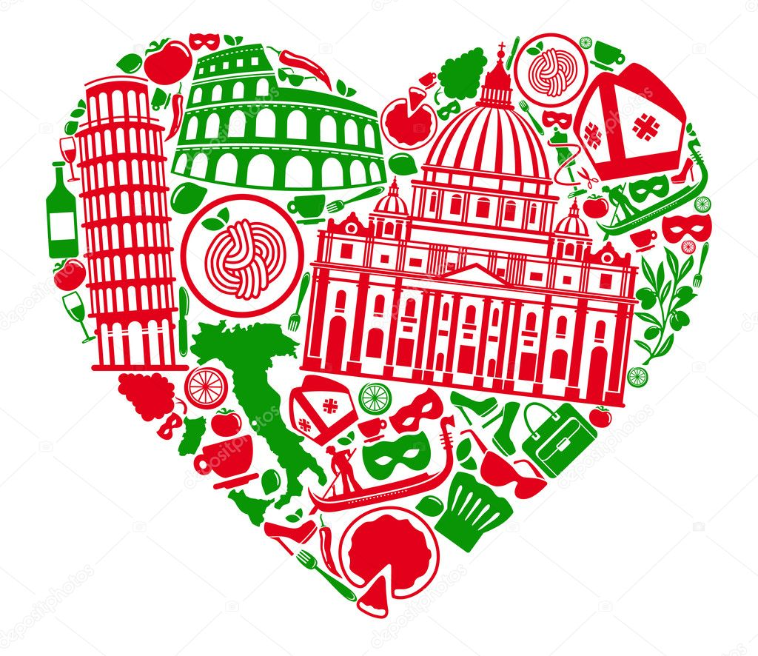
Culture
Since the rise of the Roman Empire, Italian art, architecture, and culture have had an influence around the world. Famed Italian painters include Leonardo da Vinci and Michelangelo. Italy is also at the heart of the Catholic Church, which is governed from Vatican City, a country surrounded by Rome. It is the smallest country in the world and has an area of 0.44 kilometre squared!
Family is at the center of Italian society. Young people often live at home until they are in their 30s, even if they have a job. When parents retire, they often go to live with their children.

Slide 6
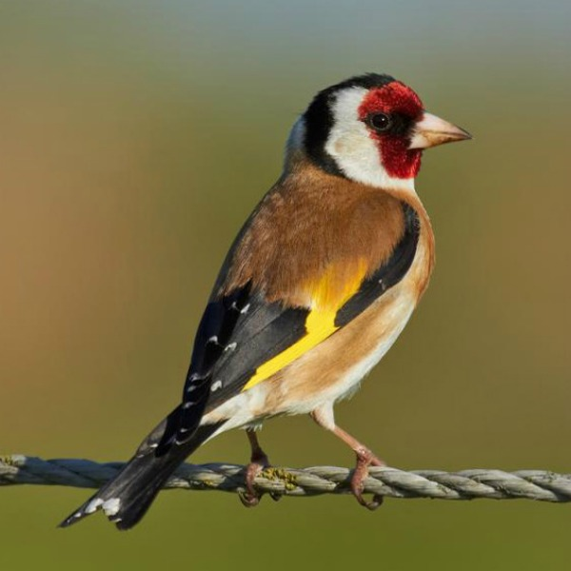
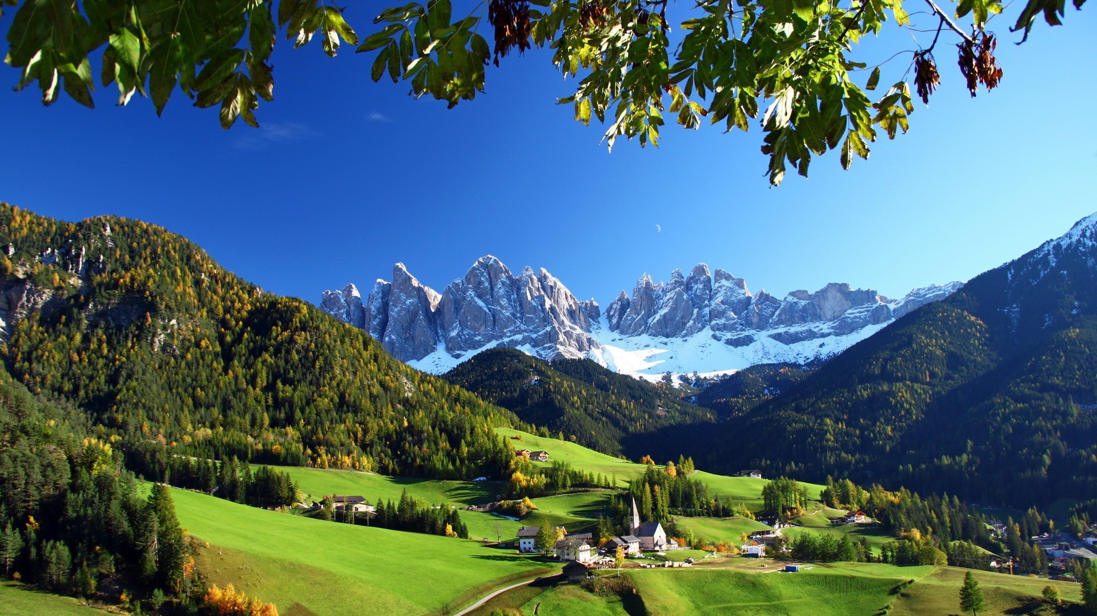
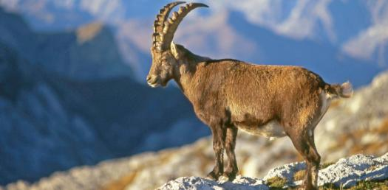
Nature
For 22 centuries, Italians and their ancestors have cleared fields, grazed livestock, and hunted wild animals. Forests that once covered large areas are gone. But the country's remote places and many national parks still have wilderness largely untouched by humans.
The lower slopes of Italy's Alps are covered with forests. Above these woodlands are meadows that explode with specially adapted wildflowers in the spring. Throughout Italy, millions of birds stop to rest during their annual migration to Africa.

Slide 7
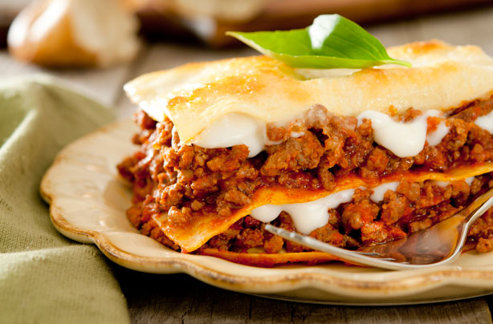
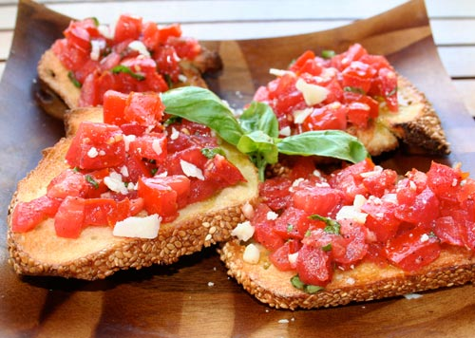
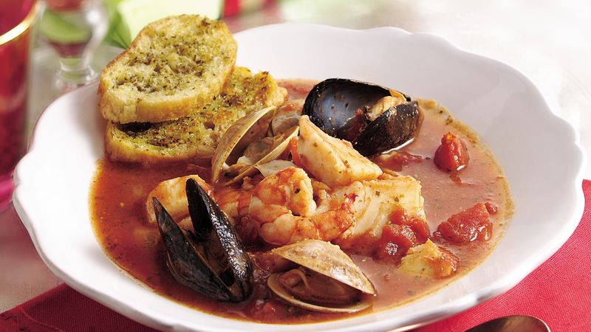
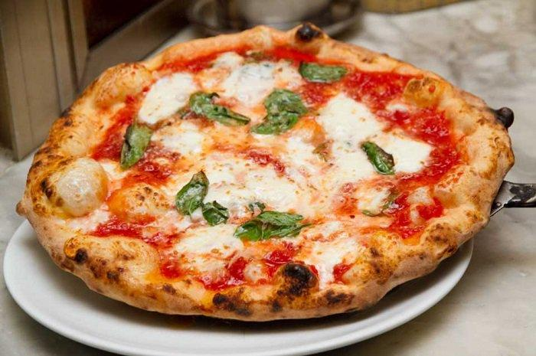
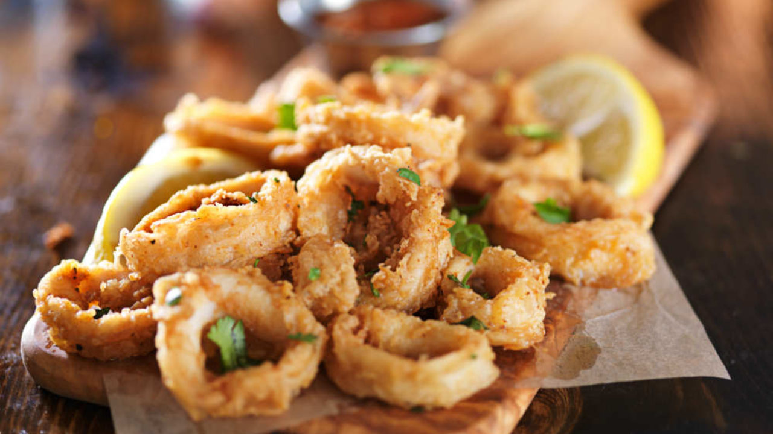
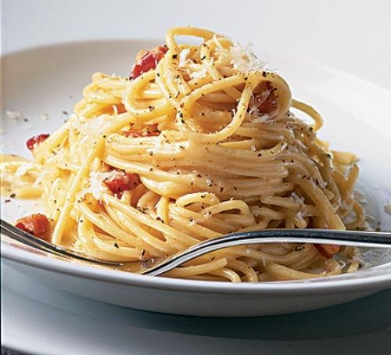
Italian Food
Italian cuisine is very famous and admired around the world. For Italians, food is an art, which they master very well and their gatherings are centered around food. Pizza came from Naples and it is really popular in central Italy aswell as carbonara, lasagne and spaghetti dishes such as Bolognese, which comes from Bologna. However, in the north, the most common dishes are comprised of fish, potatoes, rice, pork, pasta, polenta and risotto. In the south, tomatoes are a staple food, either served fresh or cooked into sauce with peppers, olives and olive oil, garlic, artichokes, aubergine and ricotta cheese. Food is a means for being social with family and friends, and there is a special meal for every occasion.

Slide 8
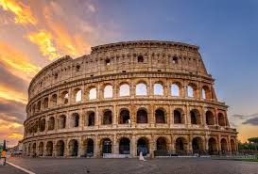
Famous Landmarks The Colosseum, Rome
The Colosseum is one of the landmarks most people can easily link to Italy. The huge oval amphitheatre stands in the city centre of Rome where six million tourists visit it each year! Construction started in 70 AD. Built in Roman design borrowed from the Greeks, the amphitheatre was built where on a dried out lake. The colosseum was the place in those days where the Romans held their popular fights and games for entertainment. There were gladiator fights, animal hunts and much more. About 50,000 people could be seated on the steps of this ancient amphitheatre.

Slide 9
The Leaning Tower Of Pisa, Pisa
The Leaning Tower Of Pisa was constructed in 1173 but the structure was miscalculated and built on not so solid ground, so the tower began leaning early on! It is said that Italian scientist Galileo Galilei used the tower for various gravity experiments, such as dropping various objects from the top of the tower. The tower is only about 57 metres tall while the tower's tilt is actually more than 4.3metres when measured. In 1999 some soil was taken away from underneath the tower, to lower the degree of the tilt and pull the tower more upright so it would not topple over. To reach the top of the tower there would be 294 steps to climb! Also, it is in fact the city cathedral’s bell tower.

Slide 10
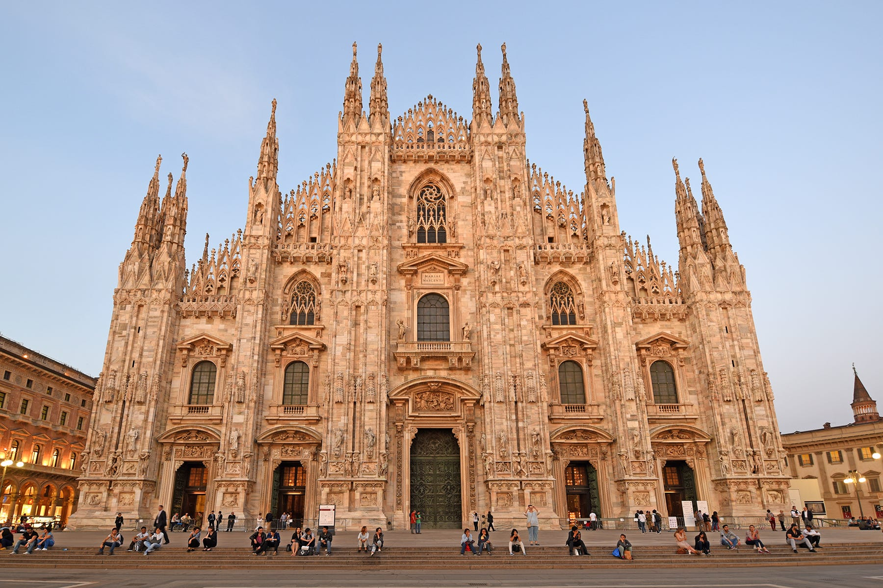
The Duomo di Milano, Milan
The cathedral in Milan is one of the most spectacular buildings in Italy. It took almost 600 years to build. The Duomo di Milano cathedral is the third largest churchs in the world and also in Italy the second largest, after the Vatican’s St.Peter’s Basilica. Milan is also known as Italian fashion and shopping capital and is home to one of Italy's most popular soccer clubs, A.C. Milan.

Slide 11
Juliet’s Balcony, Verona
Even though Juliet Capulet is a fictional character created by Shakespeare, millions worship her as a love goddess. Every year tourists from around the globe flock to Verona just to see the balcony where she fell in love with Romeo.
Juliet’s Balcony or House of Juliet, was the former home of the Cappello family and the inspiration for the Capulets. Love struck couples linger in the garden, pose for pictures on the balcony, or attach letters filled with sweet notes to the walls. For good luck, many like to cop a feel off the bronze statue of Juliet, specifically her lower right chest. Many people also leave their mark through graffiti and sticking chewing gum to the walls, some of the blobs being shaped into crude hearts.

Slide 12
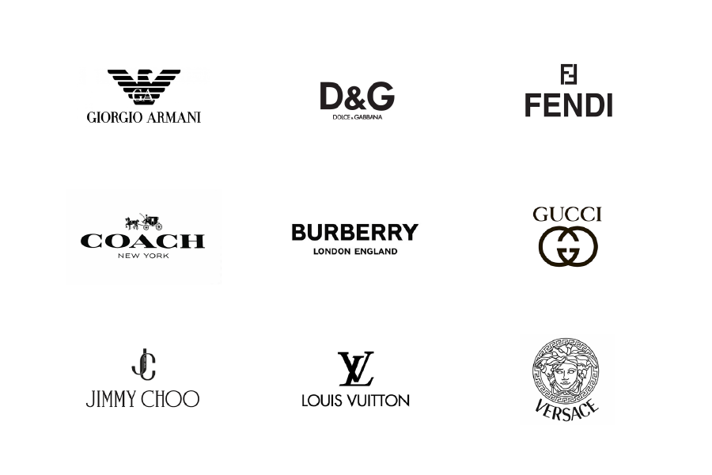
Fashion
Fashion in Italy is very famous. After all, Milan is one of the Fashion Capitals along side New York, Paris and London. Many of Italian fashion evolved from art and different artistic patterns and sequences would be printed on to luxurious materials that people would wear. Many, many designer brands came from Italy, including Versace, Louis Vuitton, Fendi, Dolce Gabanna, Gucci, Prada, Armani, Jimmy Choo, Valentino, Moschino, Givenchy and a lot more.

Slide 13
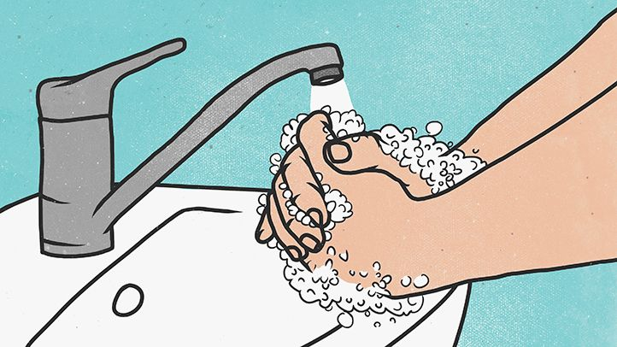
Thanks for watching my project, hope you enjoyed!!
Stay safe

